Slide 1

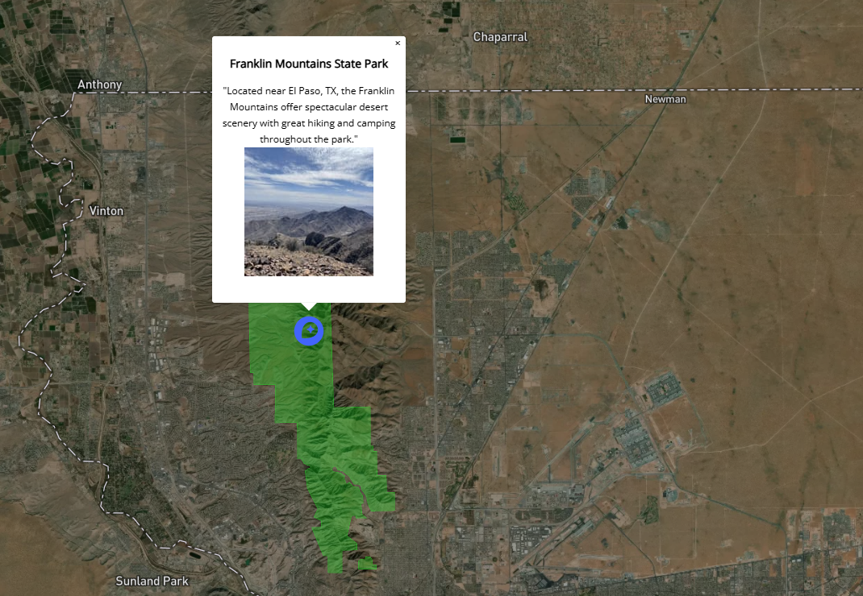
Texas state parks

Slide 2
Visualization Approach & Design
interactive map providing park names, facts & boundaries
Base map designed on mapbox
Geojson FILE format

Slide 3
Data
GEOSJON Uploads
Polygons (Park Boundaries) – state_parks_polygon.geosjon
Points (Park Names) – state_parks_points.geojson
Interactive Markers - Individually added to map in Geosjon format
Source
GitHub - texas/maps: A repository of Texas geodata.
http://www.tpwd.state.tx.us/landwater/land/maps/gis/data_downloads/

Slide 4
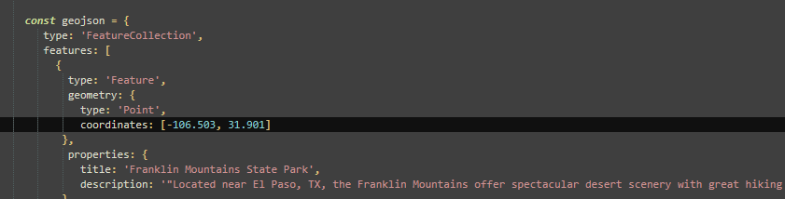
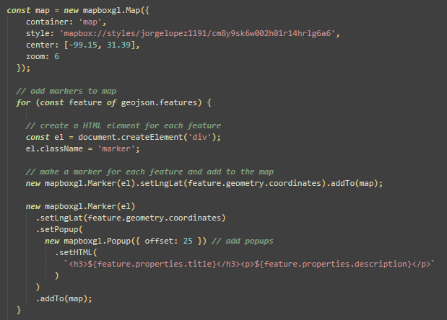
Code
Boundary & name features were uploaded as tilesets in base map.
Interactive custom markers created with Mapbox tutorial.
Add custom markers in Mapbox GL JS | Help | Mapbox

Slide 5
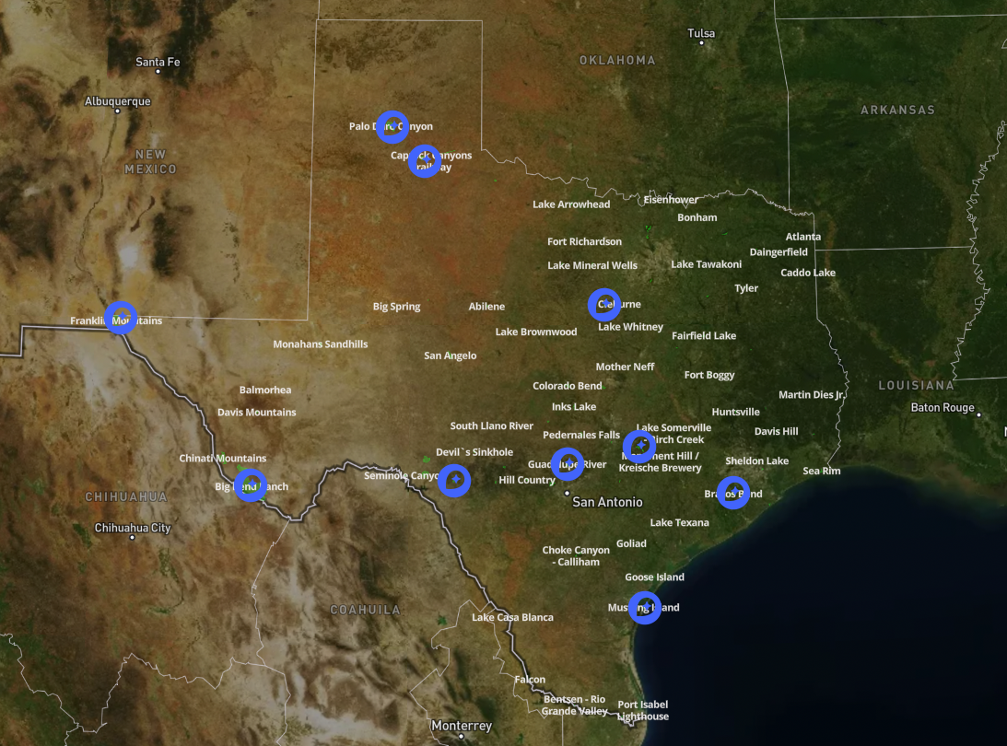
Thank you!

